Slide 1

Sensitivity of Ozone Formation
To Photons
Sasha Madronich
National Center for Atmospheric Research
Boulder Colorado USA
Mexico City, 14 August 2009

Slide 2
Tropospheric Ozone Formation:
Urban ozone is generated when air containing hydrocarbons and nitrogen oxides is exposed to ultraviolet radiation
- Haagen-Smit (1950s)

Slide 3
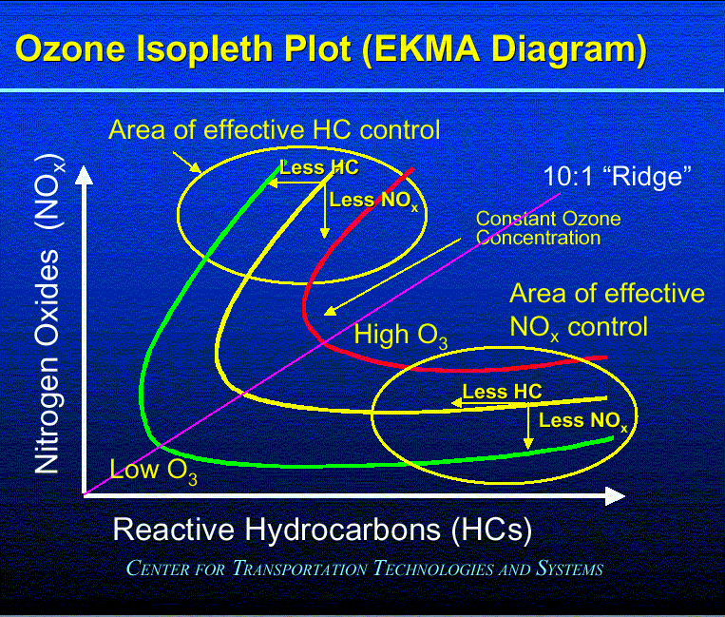

Slide 4
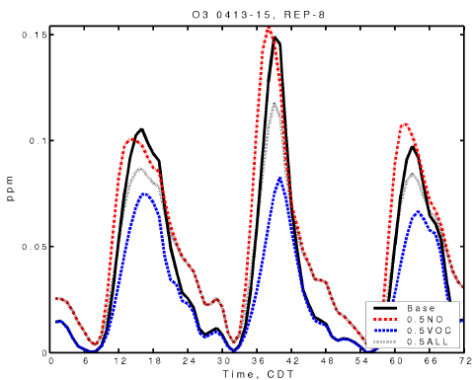
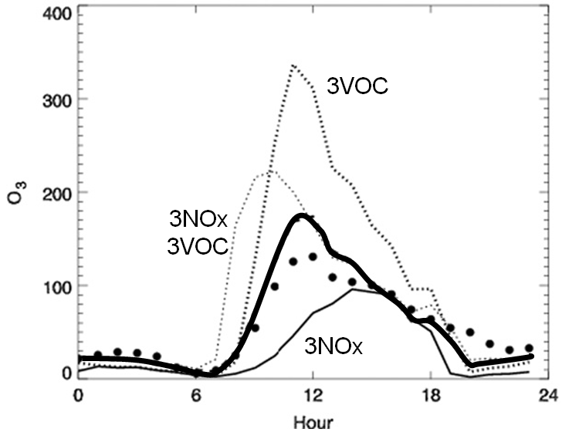
Mexico City’s O₃ Production is
VOC-limited, NOx-inhibited
WRF-Chem --- sensitivity studies
● observations
CAMx --- sensitivity studies
Tie et al., 2007
Lei et al., 2007

Slide 5
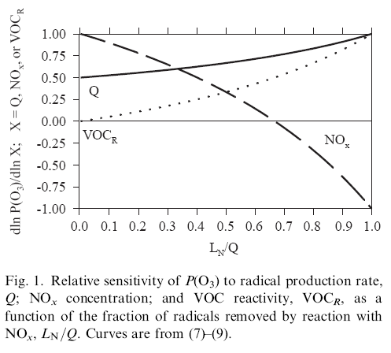
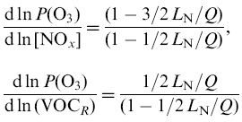

NOx-VOC
Regimes
VOC-limited
NOx-limited
NOx-inhibited
Very low NOx:
O₃ ~ J^{0.5} [NOx]
Very high NOx:
O₃ ~ J [VOC] / [NOx]

Slide 6
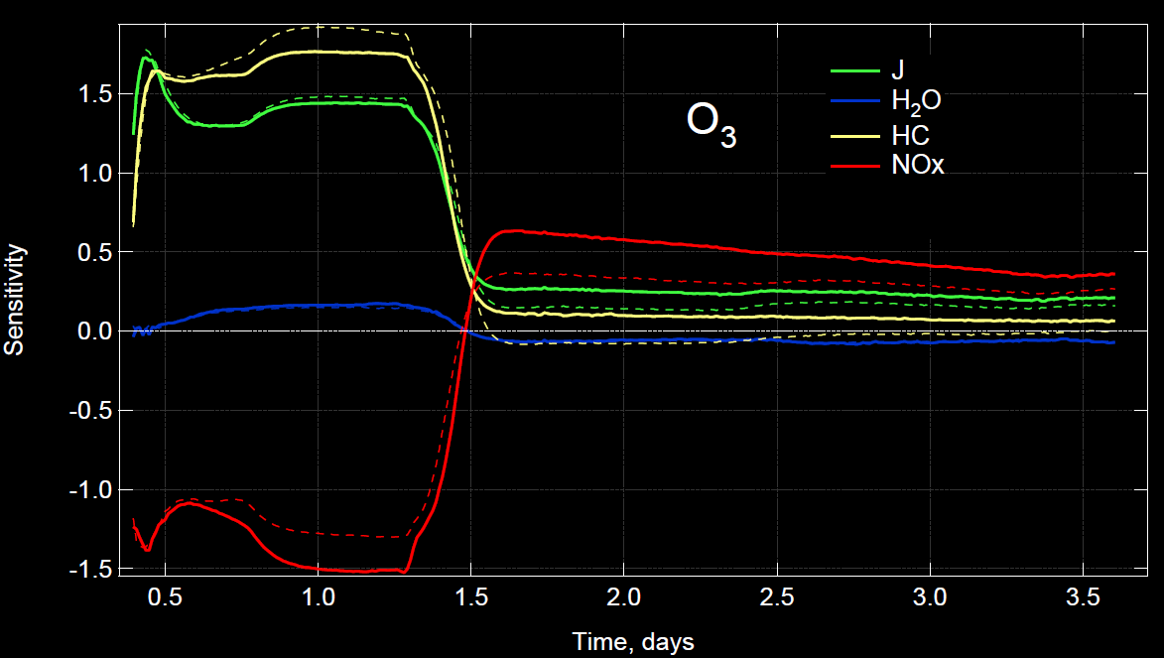
Sensitivity (%/%) of O₃ in Mexico City
NCAR Master Mechanism box model
Madronich, unpubl..

Slide 7
O₃ production is always
PHOTON-LIMITED
Radiative transfer modeling ok for ideal conditions: cloud-free, pollution-free
Large uncertainties for realistic conditions, not well modeled
Affected by long term trends in aerosols, absorbing gases, clouds
Few comprehensive studies on photon-limitation

Slide 8


Quantifying Photolysis Processes
Photolysis reaction: AB + hν → A + B
Photolysis rates:
  Photolysis frequency (s⁻¹) J = ∫_{λ} F(λ) σ(λ) φ(λ) dλ
  (other names: photo-dissociation rate coefficient, J-value)

Slide 9
CALCULATION OF
PHOTOLYSIS COEFFICIENTS
  J (s⁻¹) = ∫_{λ} F(λ) σ(λ) φ(λ) dλ
  F(λ) = spectral actinic flux, quanta cm⁻² s⁻¹ nm⁻¹
  ∝ probability of photon near molecule.
  σ(λ) = absorption cross section, cm² molec⁻¹
  ∝ probability that photon is absorbed.
  φ(λ) = photodissociation quantum yield, molec quanta⁻¹
  ∝ probability that absorbed photon causes dissociation.

Slide 10
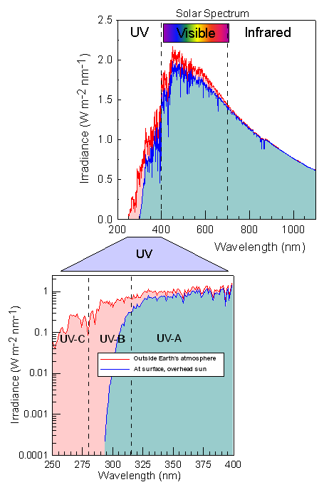
Solar Spectrum
O₂ and O₃ absorb
all UV-C (λ<280 nm)
before it reaches the
troposphere
UNEP, 2002

Slide 11
Spectral Region For
Tropospheric Photochemistry
surface, overhead sun
Madronich, unpubl..

Slide 12
Typical Vertical Optical Depths, τ
Direct transmission = exp(-τ)
Diffuse transmission can be much larger
Madronich, unpubl..

Slide 13
Effect of Pollutants on UV Irradiance
Model calculations for 21 June, 35 N, noon, pollutants distributed over
a 1 km boundary layer
Madronich, unpubl..

Slide 14
UV Actinic Flux Reduction → Slower Photochemistry
Mexico City (T1)
Madronich, Shetter, Halls, Lefer, AGU’07

Slide 15
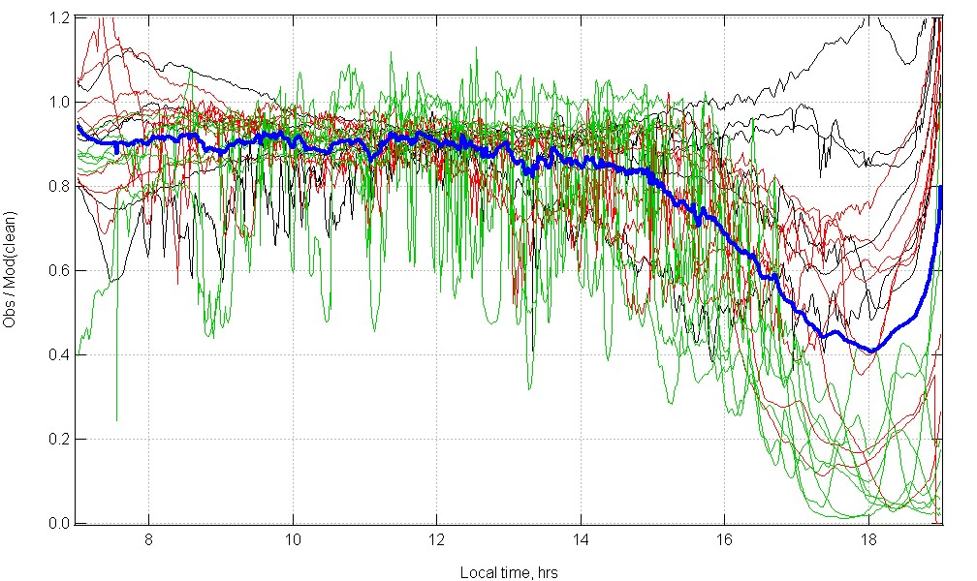
J_{NO2} Observed/Model_clean
March 2006 T1 supersite
thin curves = individual days
thick blue curve = average
Madronich, unpubl..

Slide 16
Aerosol Impacts on Photochemistry
NO₂ + hν → NO + O (at surface)
Castro et al. 2001

Slide 17
O₃ Suppression from Aerosol (Mexico City)
Castro et al. 2001

Slide 18
Vertical Structure of Aerosol Effects
NO₂ Photolysis Frequency
19N, April, noon, AOD = 1 at 380 nm
Castro et al. 2001

Slide 19
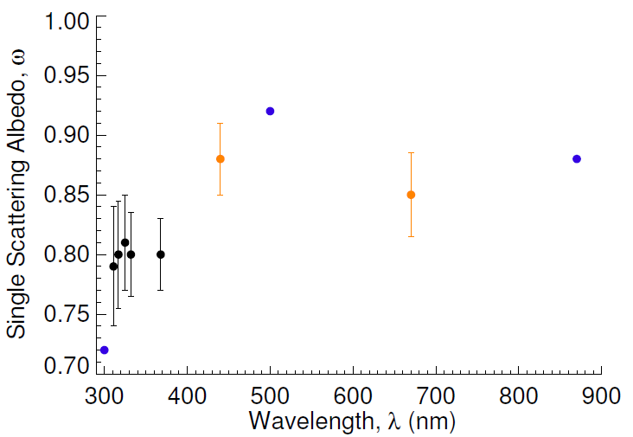
Aerosol Single Scattering Albedo
Mexico City
UV-MFRSR (T1)
AERONET (T1)
Barnard et al. (CENICA)
Corr et al., 2009

Slide 20
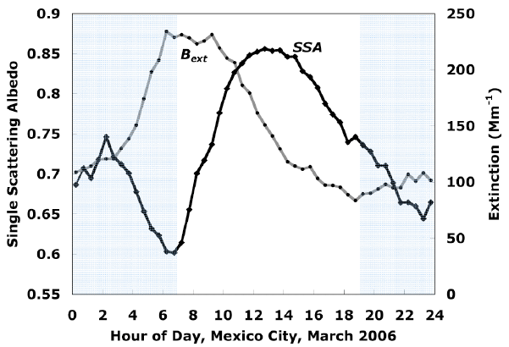
DIURNAL CYCLE OF AEROSOL OPTICS
550 nm
Paredes-Miranda et al., 2008

Slide 21
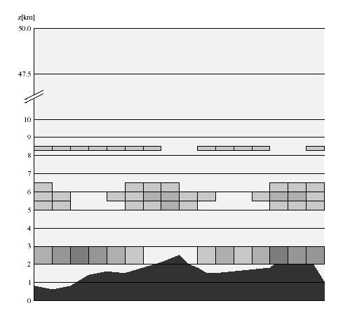
Clouds

Slide 22
UNIFORM CLOUD LAYER
Above cloud: - high radiation because of reflection
Below cloud: - lower radiation because of attenuation by cloud
Inside cloud: - complicated behavior
  Top half: very high values (for high sun)
  Bottom half: lower values

Slide 23
EFFECT OF UNIFORM CLOUDS ON ACTINIC FLUX
Madronich, 1987

Slide 24
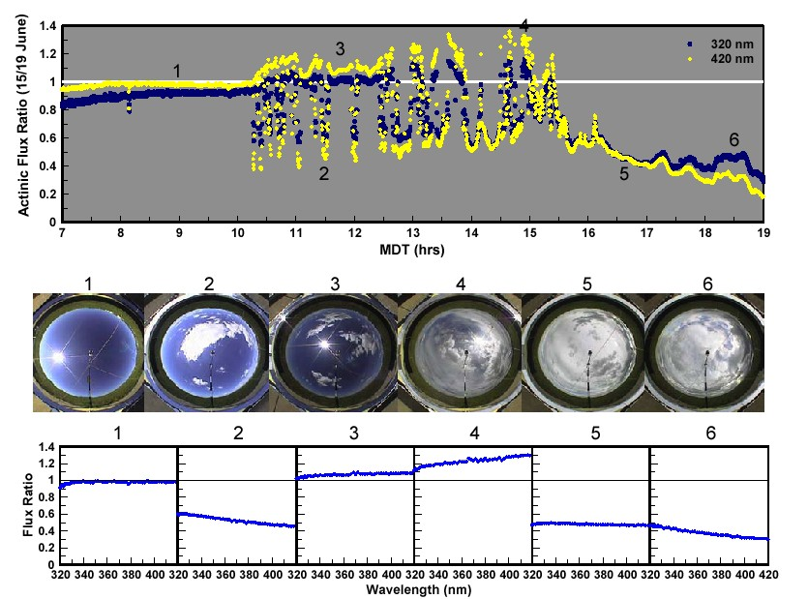
SPECTRAL EFFECTS OF PARTIAL CLOUD COVER
Crafword et al., 2003

Slide 25
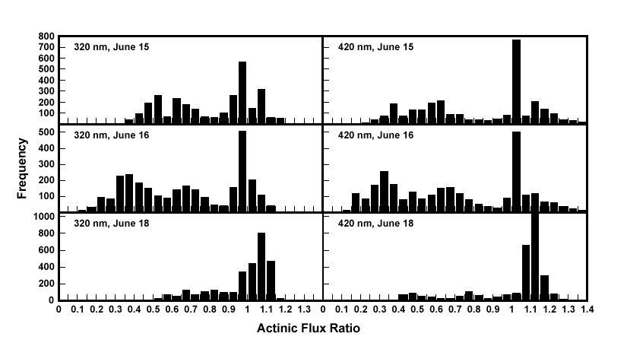
PARTIAL CLOUD COVER
Biomodal distributions
Crafword et al., 2003

Slide 26
WRF-Chem Regional O₃ Prediction
Observed daily 1-h maximum O3 for all EPA AIRNOW surface stations in the model domain, 21 July - 4 August 2002.
G.A. Grell et al. / Atmospheric Environment 39 (2005) 6957–6975

Slide 27
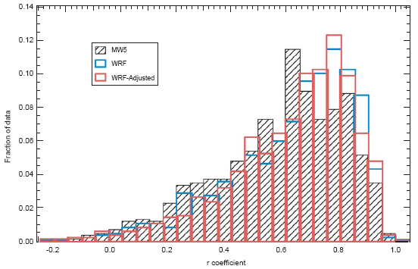
Correlation coefficient - R
scatter mostly from clouds not modeled correctly !?
G.A. Grell et al. / Atmospheric Environment 39 (2005) 6957–6975

Slide 28
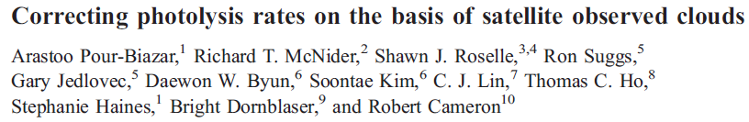
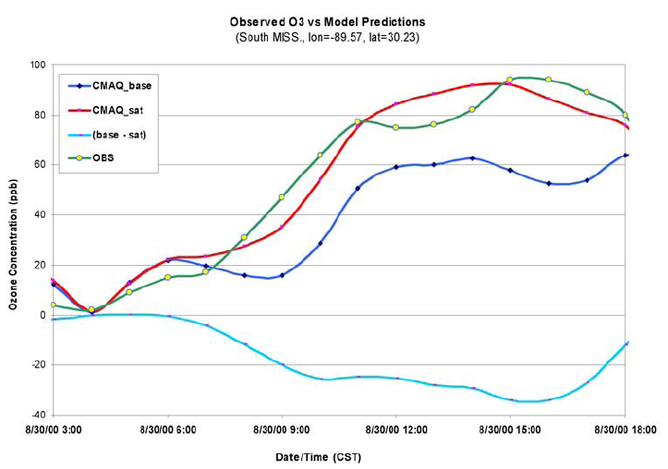

Slide 29
Mean Bias
bias mostly from aerosols not modeled correctly !?
G.A. Grell et al. / Atmospheric Environment 39 (2005) 6957–6975

Slide 30
Problems and Opportunities
O₃ productions is
  sometimes NOx limited
  sometimes VOC limited
  always photon limited
Pollution affects photon availability (10-30% reductions are not uncommon).
Aerosols and clouds change the vertical gradient of photochemistry
  usually brighter above, dimmer below (but not always)

Slide 31
UV properties of aerosols are poorly known
  Composition
  Size distributions
  Morphologies, mixing states
  Vertical distribution
VOC-NOx-photon interactions: Photon availability may change NOx-limited transition point:
O₃
High J
Low J
NOx

Slide 32
Delay of reactivity: slower urban photochemistry allows more export of precursors for regional oxidants.
Regional photochemistry may be accelerated by scattering aerosols (Dickerson et al., 1997)
Clouds: need improved cloud statistics for parameterizing optical properties. Also, how to deal with model vs. real clouds?
Need evaluation of model J-values with in situ measurements under realistic conditions. Need to demonstrate closure through the vertical extent.

